Slide 1
Facial expression classifier team: facial interpreters
Marin azhar
Joseph liu

Slide 2
About the Team
Name: Marin Azhar
College: Queens College
Major: Applied Math
Motivation for Project: I’m interested in getting one step closer to understanding how applications such as hireVue works.
Name: Joseph Liu
College: New York City College of Technology
Major: Data Science
Motivation for Project: To communicate better with others, I wish to learn how people recognize different facial expressions.

Slide 3
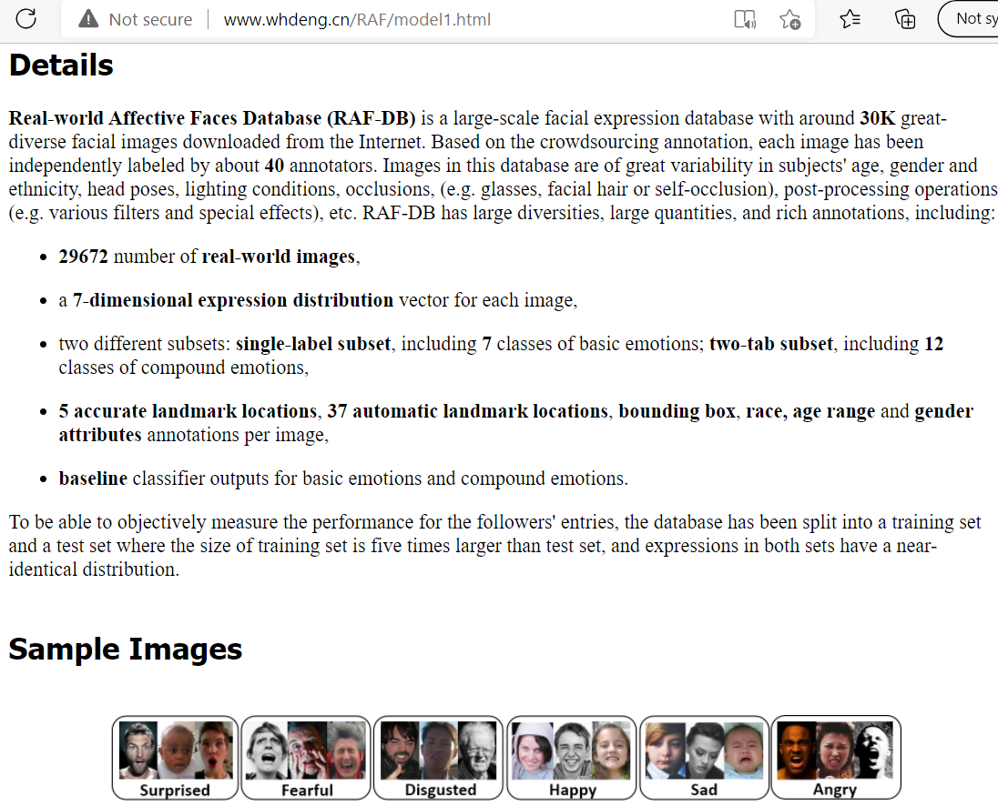
Data
descRiption
Text: ____________________________
Notes:
The data is from the Real-world Affective (RFA) Database, available for non-commercial research purposes only. There are over 15k images as our input data and one of seven different classes of basic emotions as our output.

Slide 4
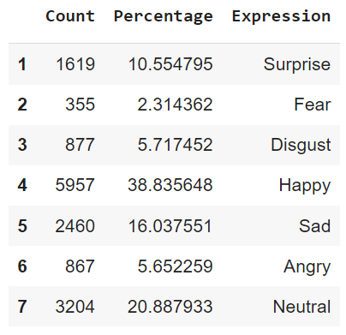
class balance
Notes:
The dataset is unbalanced; thus, to increase our model's accuracy, we will drop classes with less than 1k images.

Slide 5
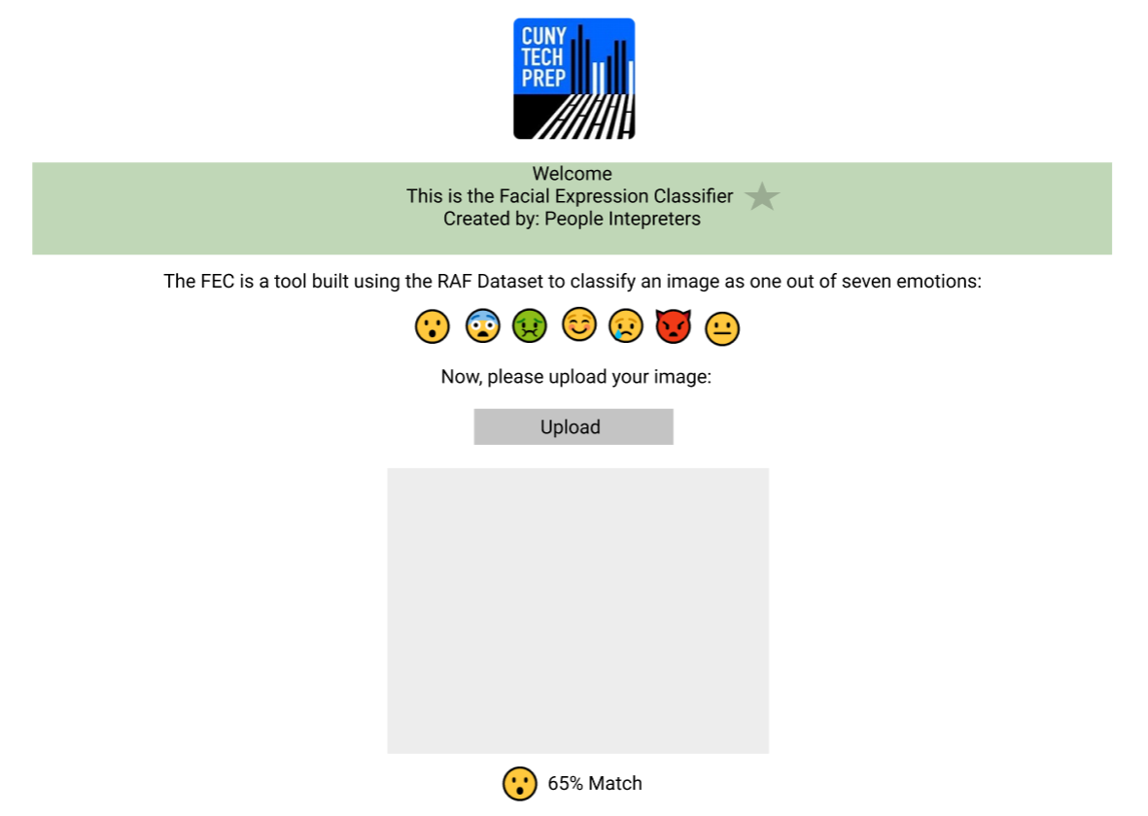

final Product?
Notes:
Our final product would be a web application. Users can upload their pictures into our facial classification model, in which the model will return an expressions class.
Our goal is to create a image classification model and website application which could used to help people better understand how others perceive their facial expressions and emotions.
The goal would also be to provide users with a predictive probability distribution of each expression class. Users could then use our application to help them understand how well they communicate their emotions through their facial features.

Slide 6
THANKS!
Do you have any questions? facial_interpreters@mail.com +91 620 421 838 company.com
Please keep this slide for attribution

